Slide 1


Tech ABC Corp - HR Database
[Khrystyne Taylor 2020/11/19]

Slide 2
Business Scenario
Business requirement
Tech ABC Corp saw explosive growth with a sudden appearance onto the gaming scene with their new AI-powered video game console. As a result, they have gone from a small 10 person operation to 200 employees and 5 locations in under a year. HR is having trouble keeping up with the growth, since they are still maintaining employee information in a spreadsheet. While that worked for ten employees, it has becoming increasingly cumbersome to manage as the company expands.
As such, the HR department has tasked you, as the new data architect, to design and build a database capable of managing their employee information.
Dataset
The HR dataset you will be working with is an Excel workbook which consists of 206 records, with eleven columns. The data is in human readable format, and has not been normalized at all. The data lists the names of employees at Tech ABC Corp as well as information such as job title, department, manager's name, hire date, start date, end date, work location, and salary.
IT Department Best Practices
The IT Department has certain Best Practices policies for databases you should follow, as detailed in the Best Practices document.

Slide 3
Step 1
Data Architecture Foundations

Slide 4
Step 1: Data Architecture Foundations
Hi,
Welcome to Tech ABC Corp. We are excited to have some new talent onboard. As you may already know, Tech ABC Corp has recently experienced a lot of growth. Our AI powered video game console WOPR has been hugely successful and as a result, our company has grown from 10 employees to 200 in only 6 months (and we are projecting a 20% growth a year for the next 5 years). We have also grown from our Dallas, Texas office, to 4 other locations nationwide: New York City, NY, San Francisco, CA, Minneapolis, MN, and Nashville, TN.
While this growth is great, it is really starting to put a strain on our record keeping in HR. We currently maintain all employee information on a shared spreadsheet. When HR consisted of only myself, managing everyone on an Excel spreadsheet was simple, but now that it is a shared document I am having serious reservations about data integrity and data security. If the wrong person got their hands on the HR file, they would see the salaries of every employee in the company, all the way up to the president.
After speaking with Jacob Lauber, the manager of IT, he suggested I put in a request to have my HR Excel file converted into a database. He suggested I reach out to you as I am told you have experience in designing and building databases. When you are building this, please keep in mind that I want any employee with a domain login to be have read only access the database. I just don't want them having access to salary information. That needs to be restricted to HR and management level employees only. Management and HR employees should also be the only ones with write access. By our current estimates, 90% of users will be read only.
I also want to make sure you know that am looking to turn my spreadsheet into a live database, one I can input and edit information into. I am not really concerned with reporting capabilities at the moment. Since we are working with employee data we are required by federal regulations to maintain this data for at least 7 years; additionally, since this is considered business critical data, we need to make sure it gets backed up properly.
As a final consideration. We would like to be able to connect with the payroll department's system in the future. They maintain employee attendance and paid time off information. It would be nice if the two systems could interface in the future
I am looking forward to working with you and seeing what kind of database you design for us.
Thanks,
Sarah Collins
Head of HR

Slide 5
Data Architect Business Requirement
Purpose of the new database:
- To manage a larger amount of data
- And to preverve data integrity and data security
Describe current data management solution:
An excel spreedsheet
Describe current data available:
The salaries of every employee in the company
Additional data requests:
Connect with the payroll department's system which would allow access to employee attendance and paid time off information.
Who will own/manage data
HR
Who will have access to database
- All employees with a domain login: read only access to the database - salary information to be restricted
- Management and HR employees: write access/ have access to salary information

Slide 6
Data Architect Business Requirement
Estimated size of database
206 rows, with eleven columns
Estimated annual growth
20% growth a year for the next 5 years
Is any of the data sensitive/restricted
Salary information needs to be restricted to HR and management level employees. Employees with a domain login should not have access to this info.

Slide 7
Data Architect Technical Requirement
Justification for the new database
To maintain data integrity and security.
Database objects
Tables: employee, employee_role, department, management, salary, address, city, state, location.
Possible Views: Salrary_info(employee name, salary, manager, department). Current_jobs(emp_name, job_title, hire_dt, manager, dept). Number of employees per manager(count of employees per manager). No of employees in each dept(count of employees per dept)
Possible special procedures: totalRecords, minSalrary, maxSalary, totalSalary(), insert_records().
Data ingestion
ETL: extract the neccasarry data from the proj_stg table(called test table in my db as I used my local machine to complete project.) to load into newly created tables within the db.
.

Slide 8
Data Architect Technical Requirement
Data governance (Ownership and User access)
Ownership: HR department.
User Access: Any employees with a domain login(have read only access) to be granted user access to all tables in the database, except the tables holding salary information, which should be restricted to HR and management level employees only(have write access).
Scalability
Sharding since hr wants a live database, one they can input and edit information into
Flexibility
JSONB data type for PostgreSQL as JSONB supports fast lookups and simple expression search queries using Generalized Inverted Indexes (GIN). Multiple support functions enable users to extract and manipulate data,
Storage & retention
Storage (disk or in-memory): A standard partition of 1 GB retained on Disk storage. If database exeeds 10k rows, a larger partition space will be requested. This is not expected at this stage as the database will only have 206 rows with an expected growth of 20%(an additional ~ 41 rows) in the next year.
Retention: At least 7 years.
Backup:
● Critical: Backup schedule is full backup 1x per week, incremental backup daily.

Slide 9
Step 2
Relational Database Design

Slide 10
Step 2: Relational Database Design
This step is where you will go through the process of designing a new database for Tech ABC Corp's HR department. Using the dataset provided, along with the requirements gathered in step one, you are going to develop a relational database set to the 3NF.
Using Lucidchart, you will create 3 entity relationship diagrams (ERDs) to show how you developed the final design for your data.
You will submit a screenshot for each of the 3 ERDs you create. You will find detailed instructions for developing each of the ERDs over the next several pages.

Slide 11
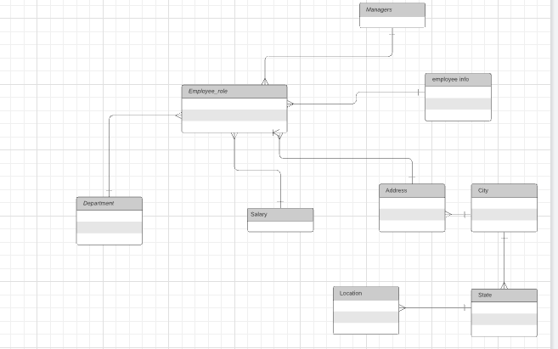
ERD
Conceptual
This is the most general level of data modeling. At the conceptual level, you should be thinking about creating entities that represent business objects for the database. Think broadly here. Attributes (or column names) are not required at this point, but relationship lines are required (although Crow's foot notation is not needed at this level). Create at least three entities for this model; thinking about the 3NF will aid you in deciding the type of entities to create.
Use Lucidchart’s built-in template for DBMS ER Diagram UML.
** Replace example screenshot below with your response

Slide 12
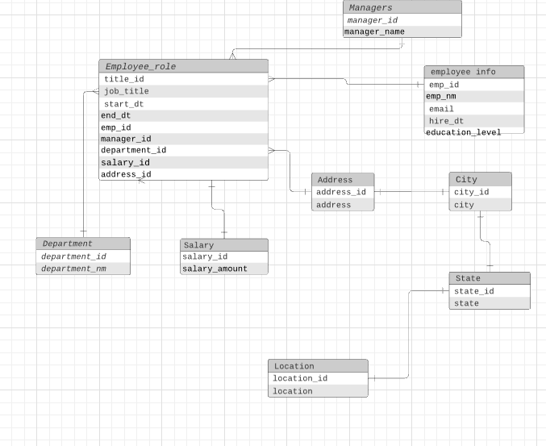
ERD
Logical
The logical model is the next level of refinement from the conceptual ERD. At this point, you should have normalized the data to the 3NF. Attributes should also be listed now in the ERD. You can still use human-friendly entity and attribute names in the logical model, and while relationship lines are required, Crow's foot notation is still not needed at this point.

Slide 13
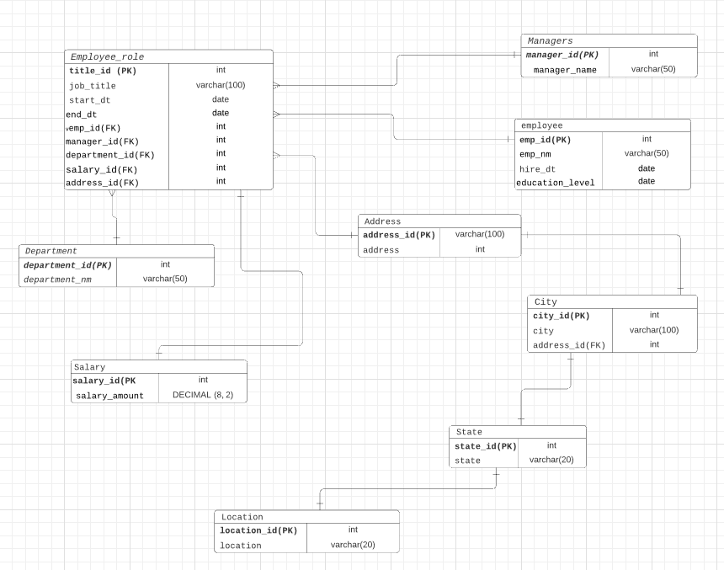
ERD
Physical
The physical model is what will be built in the database. Each entity should represent a database table, complete with column names and data types. Primary keys and foreign keys should also be represented here. Primary keys should be in bold type with the (PK) designation following the field name. Foreign keys should be in normal type face, but have the designation (FK) after the column name. Finally, in the physical model, Crow's foot notation is important.

Slide 14
Step 3
Create A Physical Database

Slide 15
Step 3: Create A Physical Database
In this step, you will be turning your database model into a physical database.
You will:
Create the database using SQL DDL commands
Load the data into your database, utilizing flat file ETL
Answer a series of questions using CRUD SQL commands to demonstrate your database was created and populated correctly
Submission
For this step, you will need to submit SQL files containing all DDL SQL scripts used to create the database.
You will also have to submit screenshots showing CRUD commands, along with results for each of the questions found in the starter template.
Hints
Your DDL script will be graded by running the code you submit. Please ensure your SQL code runs properly!
Foreign keys cannot be created on tables that do not exist yet, so it may be easier to create all tables in the database, then to go back and run modify statements on the tables to create foreign key constraints.
After running CRUD commands like update, insert, or delete, run a SELECT* command on the affected table, so the reviewer can see the results of the command.

Slide 16
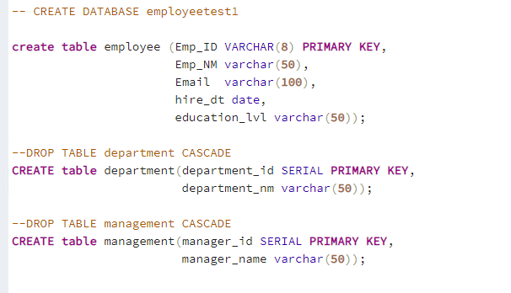
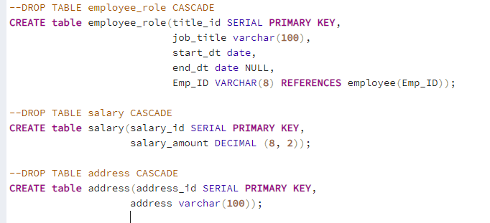
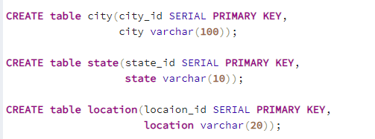
DDL
Create a DDL SQL script capable of building the database you designed in Step 2

Slide 17
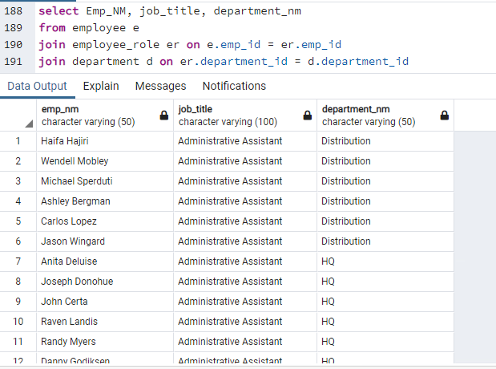
CRUD
Question 1: Return a list of employees with Job Titles and Department Names
** Replace example screenshot below with your response, and include the query in a SQL file

Slide 18
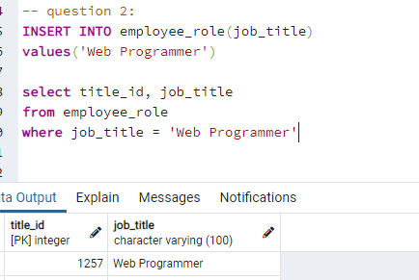
CRUD
Question 2: Insert Web Programmer as a new job title
** Replace example screenshot below with your response, and include the query in a SQL file

Slide 19
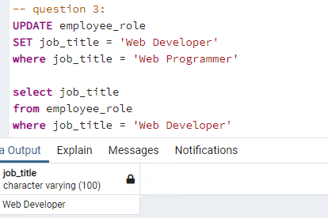
CRUD
Question 3: Correct the job title from web programmer to web developer
** Replace example screenshot below with your response, and include the query in a SQL file

Slide 20
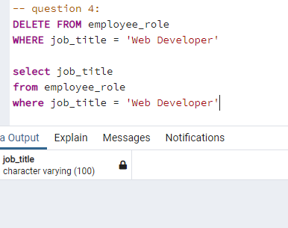
CRUD
Question 4: Delete the job title Web Developer from the database
** Replace example screenshot below with your response, and include the query in a SQL file

Slide 21
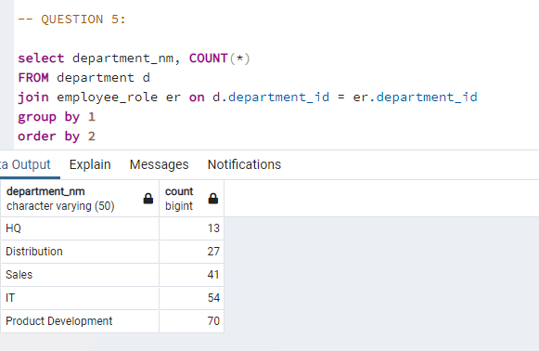
CRUD
Question 5: How many employees are in each department?
** Replace example screenshot below with your response, and include the query in a SQL file

Slide 22
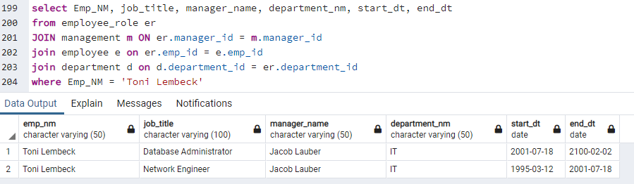
CRUD
Question 6: Write a query that returns current and past jobs (include employee name, job title, department, manager name, start and end date for position) for employee Toni Lembeck.
** Replace example screenshot below with your response, and include the query in a SQL file

Slide 23
CRUD
Question 7: Describe how you would apply table security to restrict access to employee salaries using an SQL server.
** answer in a short paragraph, how you would apply table security to restrict access to employee salaries
I will use DATA CONTROL LANGUAGE (DCL) to manage the rights users have to tables
- Specifically, the REVOKE clause will be utilized to revoke access to the salary table for any employee with a domain login.

Slide 24
Step 4
Above and Beyond (optional)

Slide 25
Step 4: Above and Beyond
This last step is called Above and Beyond. In this step, I have proposed 3 challenges for you to complete, which are above and beyond the scope of the project. This is a chance to flex your coding muscles and show everyone how good you really are.
These challenge steps will bring your project even more in line with a real-world project, as these are the kind of “finishing touches” that will make your database more usable. Imagine building a car without air conditioning or turn signals. Sure, it will work, but who would want to drive it.
I encourage you to take on these challenges in this course and any future courses you take. I designed these challenges to be a challenge to your current abilities, but I ensured they are not an unattainable challenge. Remember, these challenges are completely optional - you can pass the project by doing none of them, or just some of them, but I encourage you to at least attempt them!

Slide 26
Standout Suggestion 1
Create a view that returns all employee attributes; results should resemble initial Excel file
** return a screenshot of the view create code, along with the results of a select all on the view

Slide 27
Standout Suggestion 2
Create a stored procedure with parameters that returns current and past jobs (include employee name, job title, department, manager name, start and end date for position) when given an employee name.
** submit screenshot of stored procedure creation code, along with a screenshot of the stored procedure executed using Toni Lembeck as the parameter value

Slide 28
Standout Suggestion 3
Implement user security on the restricted salary attribute.
Create a non-management user named NoMgr. Show the code of how your would grant access to the database, but revoke access to the salary data.
Submit screenshot of code

Slide 29
Appendix

Slide 30
Additional Info
You can include supporting or additional information that supports your previous slides, but isn’t necessary for every person to see that looks at your slides.

